Slide 1

Chapter 3 Transport Layer
Computer Networking: A Top-Down Approach 8th edition Jim Kurose, Keith Ross Pearson, 2020
Acknowledgement: Based on the textbook’s website: https://gaia.cs.umass.edu/kurose_ross/index.php
Notes:
Version History
8.0 (April 2020)
All slides reformatted for 16:9 aspect ratio
All slides updated to 8th edition material
Use of Calibri font, rather that Gill Sans MT
Add LOTS more animation throughout
added new 8th edition material on QUIC, CUBIC, delay-based congestion control
lighter header font
8.2 (July 2023): changes from 8.0
minor updates throughout, but not much changes from 8.0

Slide 2

Chapter 3: roadmap
Transport-layer services
Multiplexing and demultiplexing
Connectionless transport: UDP
Connection-oriented transport: TCP
Principles of congestion control
TCP congestion control
Evolution of transport-layer functionality

Slide 3
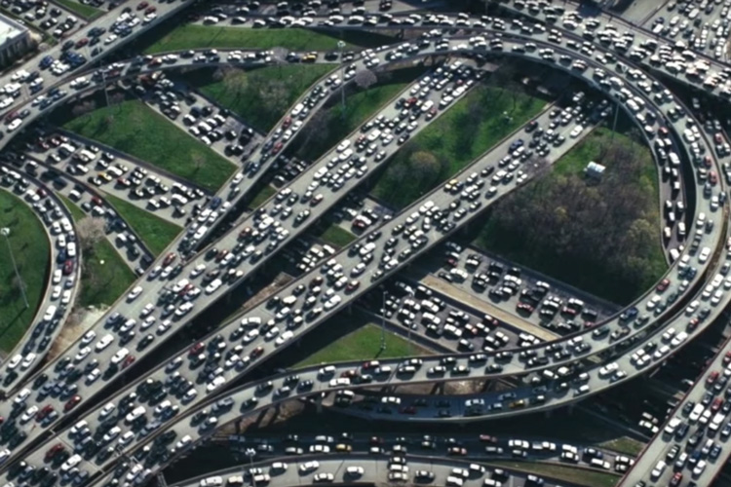


Principles of congestion control
IMPORTANT
Congestion:
informally: “too many sources sending too much data too fast for network to handle”
manifestations:
long delays (queueing in router buffers)
packet loss (buffer overflow at routers)
different from flow control!
congestion control: too many senders, sending too fast
a top-10 problem!
flow control: one sender too fast for one receiver

Slide 4

Causes/costs of congestion: scenario 1
original data: λ_{in}
throughput: λ_{out}
Simplest scenario:
Host A
one router, infinite buffers
input, output link capacity: R
infinite shared output link buffers
two flows
R
R
no retransmissions needed
Host B
R/2
Q: What happens as arrival rate λ_{in} approaches R/2?
λ_{out}
delay
throughput:
λ_{in}
R/2
λ_{in}
R/2
maximum per-connection throughput: R/2
large delays as arrival rate λινε approaches capacity
R/2

Slide 5
Causes/costs of congestion: scenario 2
one router, finite buffers
sender retransmits lost, timed-out packet
application-layer input = application-layer output: λ_{in} = λ_{out}
transport-layer input includes retransmissions : λ’_{in} λ_{in}
Host A
λ_{in} : original data
λ'_{in}: original data, plus retransmitted data
λ_{out}
R
R
Host B
finite shared output link buffers

Slide 6
Causes/costs of congestion: scenario 2
Idealization: perfect knowledge
sender sends only when router buffers available
R/2
λ_{out}
throughput:
Host A
λ_{in} : original data
λ_{in}
copy
λ'_{in}: original data, plus retransmitted data
λ_{out}
R/2
free buffer space!
R
R
Host B
finite shared output link buffers

Slide 7
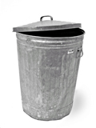
Causes/costs of congestion: scenario 2
Idealization: some perfect knowledge
packets can be lost (dropped at router) due to full buffers
sender knows when packet has been dropped: only resends if packet known to be lost
Host A
λ_{in} : original data
copy
λ'_{in}: original data, plus retransmitted data
no buffer space!
R
R
Host B
finite shared output link buffers

Slide 8
Causes/costs of congestion: scenario 2
Idealization: some perfect knowledge
packets can be lost (dropped at router) due to full buffers
sender knows when packet has been dropped: only resends if packet known to be lost
R/2
λ_{out}
“wasted” capacity due to retransmissions
when sending at R/2, some packets are needed retransmissions
throughput:
Host A
λ_{in} : original data
λ_{in}
λ'_{in}: original data, plus retransmitted data
R/2
free buffer space!
R
R
Host B
finite shared output link buffers

Slide 9


Causes/costs of congestion: scenario 2
Realistic scenario: un-needed duplicates
packets can be lost, dropped at router due to full buffers – requiring retransmissions
but sender times can time out prematurely, sending two copies, both of which are delivered
R/2
λ_{out}
“wasted” capacity due to un-needed retransmissions
throughput:
when sending at R/2, some packets are retransmissions, including needed and un-needed duplicates, that are delivered!
Host A
λ_{in} : original data
λ_{in}
copy
λ'_{in}: original data, plus retransmitted data
R/2
timeout
free buffer space!
R
R
Host B
finite shared output link buffers

Slide 10
Causes/costs of congestion: scenario 2
Realistic scenario: un-needed duplicates
packets can be lost, dropped at router due to full buffers – requiring retransmissions
but sender times can time out prematurely, sending two copies, both of which are delivered
R/2
λ_{out}
“wasted” capacity due to un-needed retransmissions
throughput:
when sending at R/2, some packets are retransmissions, including needed and un-needed duplicates, that are delivered!
λ_{in}
R/2
“costs” of congestion:
more work (retransmission) for given receiver throughput
unneeded retransmissions: link carries multiple copies of a packet
decreasing maximum achievable throughput

Slide 11
Causes/costs of congestion: scenario 3
four senders
multi-hop paths
timeout/retransmit
Q: what happens as λ_{in} and λ_{in}’ increase ?
A: as red λ_{in}’ increases, all arriving blue pkts at upper queue are dropped, blue throughput g 0
Host A
λ_{in} : original data
λ'_{in}: original data, plus retransmitted data
Host B
finite shared output link buffers
Host D
λ_{out}
Host C

Slide 12
Causes/costs of congestion: scenario 3
R/2
λ_{out}
λ_{in}’
R/2
another “cost” of congestion:
when packet dropped, any upstream transmission capacity and buffering used for that packet was wasted!

Slide 13
Causes/costs of congestion: insights
throughput can never exceed capacity
delay increases as capacity approached
loss/retransmission decreases effective throughput
un-needed duplicates further decreases effective throughput
upstream transmission capacity / buffering wasted for packets lost downstream

Slide 14
Approaches towards congestion control
IMPORTANT
End-end congestion control:
no explicit feedback from network
congestion inferred from observed loss, delay
ACKs
data
data
ACKs
approach taken by TCP

Slide 15
Approaches towards congestion control
IMPORTANT
Network-assisted congestion control:
routers provide direct feedback to sending/receiving hosts with flows passing through congested router
may indicate congestion level or explicitly set sending rate
explicit congestion info
ACKs
data
data
ACKs
TCP ECN, ATM, DECbit protocols

Slide 16
Chapter 3: roadmap
Transport-layer services
Multiplexing and demultiplexing
Connectionless transport: UDP
Principles of reliable data transfer
Connection-oriented transport: TCP
Principles of congestion control
TCP congestion control
Evolution of transport-layer functionality

Slide 17
TCP congestion control: AIMD
IMPORTANT
approach: senders can increase sending rate until packet loss (congestion) occurs, then decrease sending rate on loss event
Additive Increase
Multiplicative Decrease
increase sending rate by 1 maximum segment size every RTT until loss detected
cut sending rate in half at each loss event
AIMD sawtooth
behavior: probing
for bandwidth
TCP sender Sending rate
time

Slide 18
TCP AIMD: more
IMPORTANT
Multiplicative decrease detail: sending rate is
Cut in half on loss detected by triple duplicate ACK (TCP Reno)
Cut to 1 MSS (maximum segment size) when loss detected by timeout (TCP Tahoe)
Why AIMD?
AIMD – a distributed, asynchronous algorithm – has been shown to:
optimize congested flow rates network wide!
have desirable stability properties

Slide 19
TCP congestion control: details
IMPORTANT
sender sequence number space
TCP sending behavior:
roughly: send cwnd bytes, wait RTT for ACKS, then send more bytes
cwnd
last byte
ACKed
cwnd
sent, but not-yet ACKed
(“in-flight”)
available but not used
TCP rate
~
bytes/sec
~
RTT
last byte sent
TCP sender limits transmission:
cwnd is dynamically adjusted in response to observed network congestion (implementing TCP congestion control)
<
cwnd
LastByteSent- LastByteAcked

Slide 20
TCP slow start
IMPORTANT
Host A
Host B
when connection begins, increase rate exponentially until first loss event:
initially cwnd = 1 MSS
double cwnd every RTT
done by incrementing cwnd for every ACK received
one segment
RTT
two segments
four segments
summary: initial rate is slow, but ramps up exponentially fast
time

Slide 21
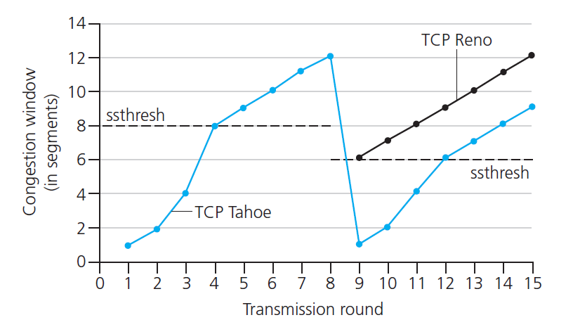

TCP: from slow start to congestion avoidance
IMPORTANT
Q: when should the exponential increase switch to linear?
A: when cwnd gets to 1/2 of its value before timeout.
X
Implementation:
variable ssthresh
on loss event, ssthresh is set to 1/2 of cwnd just before loss event
* Check out the online interactive exercises for more examples: http://gaia.cs.umass.edu/kurose_ross/interactive/

Slide 22
TCP CUBIC
IMPORTANT
Is there a better way than AIMD to “probe” for usable bandwidth?
Insight/intuition:
W_{max}: sending rate at which congestion loss was detected
congestion state of bottleneck link probably (?) hasn’t changed much
after cutting rate/window in half on loss, initially ramp to to W_{max} faster, but then approach W_{max} more slowly
W_{max}
classic TCP
TCP CUBIC - higher throughput in this example
W_{max}/2

Slide 23
TCP CUBIC
IMPORTANT
K: point in time when TCP window size will reach W_{max}
K itself is tunable
increase W as a function of the cube of the distance between current time and K
larger increases when further away from K
smaller increases (cautious) when nearer K
TCP CUBIC default in Linux, most popular TCP for popular Web servers
W_{max}
TCP Reno
TCP CUBIC
TCP
sending
rate
time
t₀
t₁
t₂
t₃
t₄

Slide 24
TCP and the congested “bottleneck link”
TCP (classic, CUBIC) increase TCP’s sending rate until packet loss occurs at some router’s output: the bottleneck link
source
destination
application
TCP
network
link
physical
application
TCP
network
link
physical
packet queue almost never empty, sometimes overflows packet (loss)
bottleneck link (almost always busy)

Slide 25
TCP and the congested “bottleneck link”
TCP (classic, CUBIC) increase TCP’s sending rate until packet loss occurs at some router’s output: the bottleneck link
understanding congestion: useful to focus on congested bottleneck link
insight: increasing TCP sending rate will not increase end-end throughout with congested bottleneck
source
destination
application
TCP
network
link
physical
application
TCP
network
link
physical
insight: increasing TCP sending rate will increase measured RTT
Goal: “keep the end-end pipe just full, but not fuller”
RTT

Slide 26
Delay-based TCP congestion control
Keeping sender-to-receiver pipe “just full enough, but no fuller”: keep bottleneck link busy transmitting, but avoid high delays/buffering
# bytes sent in last RTT interval
RTT_{measured}
measured
throughput
=
RTT_{measured}
Delay-based approach:
RTT_{min} - minimum observed RTT (uncongested path)
uncongested throughput with congestion window cwnd is cwnd/RTT_{min}
if measured throughput “very close” to uncongested throughput
increase cwnd linearly /* since path not congested */
else if measured throughput “far below” uncongested throughout
decrease cwnd linearly /* since path is congested */

Slide 27
Delay-based TCP congestion control
congestion control without inducing/forcing loss
maximizing throughout (“keeping the just pipe full… ”) while keeping delay low (“…but not fuller”)
a number of deployed TCPs take a delay-based approach
BBR deployed on Google’s (internal) backbone network

Slide 28
Explicit congestion notification (ECN)
TCP deployments often implement network-assisted congestion control:
two bits in IP header (ToS field) marked by network router to indicate congestion
policy to determine marking chosen by network operator
congestion indication carried to destination
destination sets ECE bit on ACK segment to notify sender of congestion
involves both IP (IP header ECN bit marking) and TCP (TCP header C,E bit marking)
source
TCP ACK segment
destination
application
TCP
network
link
physical
application
TCP
network
link
physical
ECE=1
ECN=10
ECN=11
IP datagram

Slide 29
TCP fairness
Fairness goal: if K TCP sessions share same bottleneck link of bandwidth R, each should have average rate of R/K
TCP connection 1
bottleneck
router
capacity R
TCP connection 2

Slide 30
Q: is TCP Fair?
Example: two competing TCP sessions:
additive increase gives slope of 1, as throughout increases
multiplicative decrease decreases throughput proportionally
R
equal bandwidth share
Is TCP fair?
A: Yes, under idealized assumptions:
same RTT
fixed number of sessions only in congestion avoidance
loss: decrease window by factor of 2
congestion avoidance: additive increase
Connection 2 throughput
loss: decrease window by factor of 2
congestion avoidance: additive increase
Connection 1 throughput
R

Slide 31
Fairness: must all network apps be “fair”?
Fairness and UDP
multimedia apps often do not use TCP
do not want rate throttled by congestion control
instead use UDP:
send audio/video at constant rate, tolerate packet loss
there is no “Internet police” policing use of congestion control
UDP is the “bully”, and TCP is the “nice guy”
Interactive applications such as Zoom use UDP for transmitting real-time interactive media such as audio and video; Streaming video applications such as YouTube or Netflix use TCP for delivering high-quality video content that is more delay-tolerant
Fairness, parallel TCP connections
application can open multiple parallel connections between two hosts
web browsers do this , e.g., link of rate R with 9 existing connections:
new app asks for 1 TCP, gets rate R/10
new app asks for 11 TCPs, gets R/2 (R*11/20)

